Slide 1
HANDWRITING DIGIT RECOGNITION
PRESENTED BY:
SANJAY C
513121104035
THANTHAI PERIYAR GOVRNMENT INSTITUTE OF TECHNOLOGY

Slide 2
PROJECT TITLE
HANDWRITING DIGIT RECOGNITION

Slide 3


AGENDA
Problem Statement
Project overview
End Users
Solution and its proposition
The WOW in the solution
Modeling
Results
Conclusion
3/21/2024 Annual Review

Slide 4

PROBLEM STATEMENT
Develop a handwritten digit recognition system using K-Means clustering. Utilize the load_digits() dataset, visualize samples, cluster digits into groups, visualize cluster centers, and predict labels for new samples. Achieve accuracy in label prediction and provide clear documentation.

Slide 5

PROJECT OVERVIEW
The project aims to develop a handwritten digit recognition system using KMeans clustering.
Leveraging the load_digits() dataset from the sklearn.datasets, containing grayscale images of handwritten digits ranging from 0 to 9, the system proceeds with a systematic approach.
The project delivers a Python script encapsulating the digit recognition system.

Slide 6

WHO ARE THE END USERS?
Researchers in machine learning and computer vision.
Developers working on handwriting recognition applications.
Educators teaching about clustering algorithms and digit recognition.
Enthusiasts interested in exploring machine learning techniques.

Slide 7

YOUR SOLUTION AND ITS VALUE PROPOSITION
The solution proposed for the code involves leveraging KMeans clustering to categorize handwritten digits into distinct groups, enabling efficient digit recognition.
The proposition entails utilizing the load_digits() dataset to train the KMeans model, visualizing cluster centers to understand representative images, and predicting labels for new digit samples.
This solution offers a simple yet effective approach to handwritten digit recognition, applicable in various domains such as pattern recognition, image processing, and machine learning research.
3/21/2024 Annual Review

Slide 8

THE WOW IN YOUR SOLUTION
KMeans clustering simplifies handwritten digit recognition.
Straightforward grouping of digits into distinct clusters.
Visualizations aid in understanding digit patterns.
Applicable across different domains like pattern recognition.
3/21/2024 Annual Review
8

Slide 9
MODELLING
Data Preparation:
Load and preprocess the dataset.In this case, the load_digits() function from sklearn.datasets is used to load the dataset, which contains grayscale images of handwritten digits. Preprocessing may involve scaling or normalization to ensure uniformity in the data.
Exploratory Data Analysis (EDA):
Visualize sample digits to understand the dataset's characteristics, such as the range of values and the variability of digit shapes.
Model Selection:
Choose an appropriate algorithm for clustering. In this case, KMeans clustering is selected for its simplicity and effectiveness in grouping similar data points.
4.Training the Model:
Fit the KMeans model to the dataset. During training, the algorithm iteratively assigns each data point to the nearest cluster center and updates the cluster centers based on the mean of the assigned points.
9

Slide 10
5.Evaluation:
Assess the quality of the clustering, such as the inertia (sum of squared distances of samples to their closest cluster center) or silhouette score (measure of how similar an object is to its cluster compared to other clusters).
6.Visualization of Results:
Visualize the cluster centers to understand the representative images of each cluster. This step helps interpret the clusters and identify patterns within them.
7.Testing:
Optionally, test the model by predicting labels for new data samples. In this case, handwritten digit samples are provided as input to the trained model to predict their corresponding labels.
8.Interpretation:
Interpret the results and analyze the effectiveness of the model. This involves understanding the clustering structure, identifying any misclassifications, and evaluating the model's performance based on predefined metrics.

Slide 11
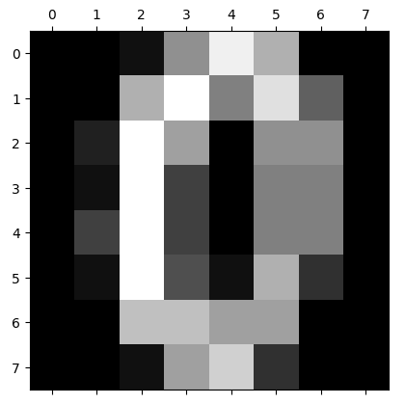
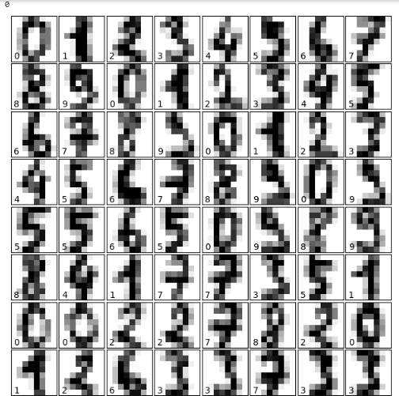
RESULTS
11

Slide 12
CONCLUSION
The provided code demonstrates a simple yet effective approach to handwritten digit recognition using KMeans clustering.
By leveraging the load_digits() dataset and visualizing cluster centers, it effectively categorizes digits into distinct groups, enabling accurate recognition of handwritten digits.
However, the evaluation of the code would be necessary to determine its robustness, scalability, and overall performance in real-world scenarios.
Overall, the code lays a solid foundation for further exploration and refinement in the field of digit recognition and clustering algorithms.

Slide 13
THANK YOU

